Slide 1

Retail Insights From Superstore Data
:-SURAJ KUMAR KUSHWAH

Slide 2

PROBLEM STATEMENT
Identify key sales trends, customer behaviors, and regional performance from superstore data to enhance decision-making. Focus on top-performing products, customer segmentation, and profitability analysis. Optimize inventory and shipping operations to improve efficiency and boost overall business performance and customer satisfaction.

Slide 3
Project Description Analyze superstore data to uncover critical insights into sales trends, customer behavior, and regional performance. This project focuses on identifying top-performing products, segmenting customers based on purchasing patterns, and optimizing inventory levels. By evaluating the effectiveness of different shipping modes and assessing profitability, the project aims to enhance decision-making, operational efficiency, and overall profitability. The ultimate goal is to provide actionable recommendations that drive business improvements, optimize costs, and improve customer satisfaction. Utilizing data analytics and visualization tools, this project will transform raw data into strategic insights for better business outcomes.

Slide 4

WHO ARE THE END USERS?
Retail Management and Executives
Sales and Marketing Teams
Supply Chain and Inventory Managers
Financial Analysts
Customer Service Teams
Business Analysts and Data Scientists
Regional Managers

Slide 5

Technology Used
1. Programming Languages:
Python: For data manipulation, analysis, and modeling.
2. Data Manipulation and Analysis Libraries:
Pandas: For data cleaning, manipulation, and analysis.
NumPy: For numerical operations and array manipulations.
3. Data Visualization Tools:
Matplotlib: For creating static, interactive, and animated visualizations in Python.
Seaborn: For statistical data visualization, built on top of Matplotlib.
Tableau/Power BI: For advanced data visualization and dashboard creation
4. VS code
For interactive data analysis and sharing insights through well-documented notebooks.

Slide 6
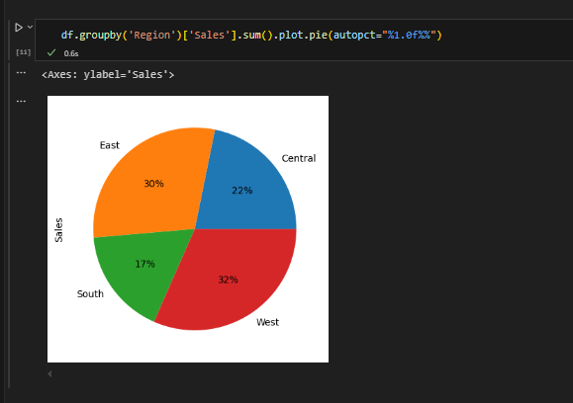
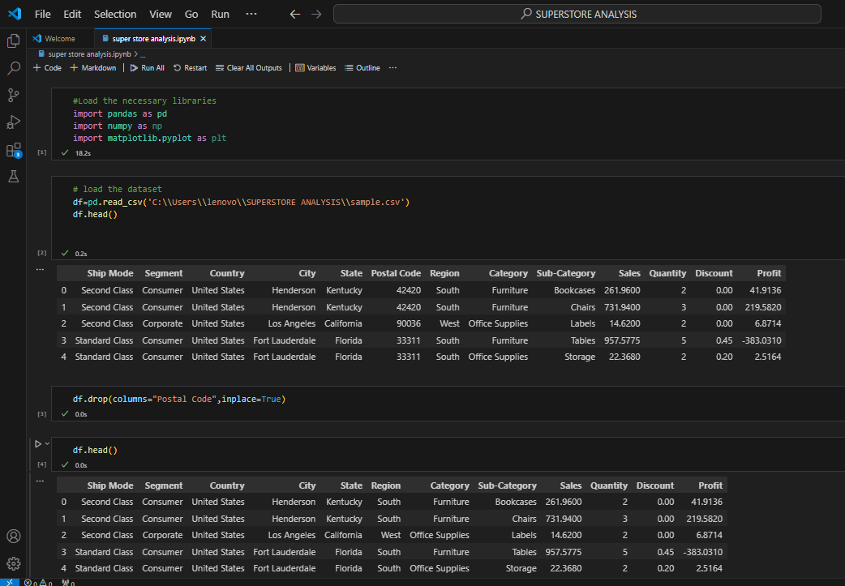
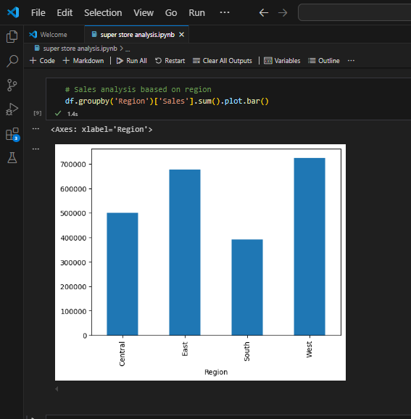
RESULTS
Project Link :-https://github.com/surajkushwah579/Retail-Insights-From-Superstore-Data.git

Slide 7
Thank you
.
.

